Slide 1
MOHAMED FARHUN M
BANNARI AMMAN INSTITUTE OF TECHNOLOGY
Theme:-Education Problem Statement:- Education in regional languages

Slide 2





Problem
Architecture Flow
Problem Statement
Education in regional languages
Theme
Education
Data Sources
Data Ingestion
Data Processing and Storage in Snowflake
Dataset used:-
State-wise Enrolment Dataset – data.gov.in and
Snowflake Marketplace - EDUCATION__LOCATIONS__INSIGHTS__AUSTRALIA
Development of an LLM (chatbot)
Streamlit Application
Data Visualization and Output)
Hypothesis
Technologies Used
This project is important as it leverages advanced data analytics and AI-driven chatbot technology to provide accessible, interactive insights into educational trends, aiding stakeholders in making informed decisions. By integrating diverse datasets, it fosters a comprehensive understanding of educational dynamics across different regions and modes of learning.

Slide 3

Insight and Recommendations #1
Insight
Title of Insight
Diverse Educational Landscape
Sector-wise School Distribution in Australia
Interactivity and Accessibility
"Global Education Insights: Bridging Disparities in Distance Learning and School Infrastructure“
Recommendation
Addressing Educational Disparities in Distance Learning:
National and State Agencies: Implement targeted educational policies and programs that address the regional disparities in distance learning enrolments.
Global Agencies:
Support research and development initiatives that focus on understanding the barriers to distance education in various regions.

Slide 4

Insight and Recommendations #2
Insight
Title of Insight
Uneven Distribution
Sector Variance
Geographical Challenges
"Equitable Ed: Transforming Australia's Educational Landscape“
Recommendation
Enhancing Educational Infrastructure in Australia:
National and State Agencies: Analyze the sector distribution of schools to identify areas where educational infrastructure, particularly in non-government sectors, may be lacking.
Global Agencies:
Advocate for and support initiatives that promote educational equity, ensuring that students, regardless of their location, have access to quality education.

Slide 5

Insight and Recommendations #3
Insight
Increased Accessibility
Cultural Preservation
Improved Learning Outcomes
Title of Insight
"Language Roots: Empowering Education Through Regional Tongues“
Recommendation
Promote Multilingual Education Policies:
National and state agencies:-
Should develop and implement educational policies ensuring that regional languages are incorporated into the curriculum
Support Research and Development:
Global agencies:- UNESCO could fund and support research on the benefits of regional language education.

Slide 6
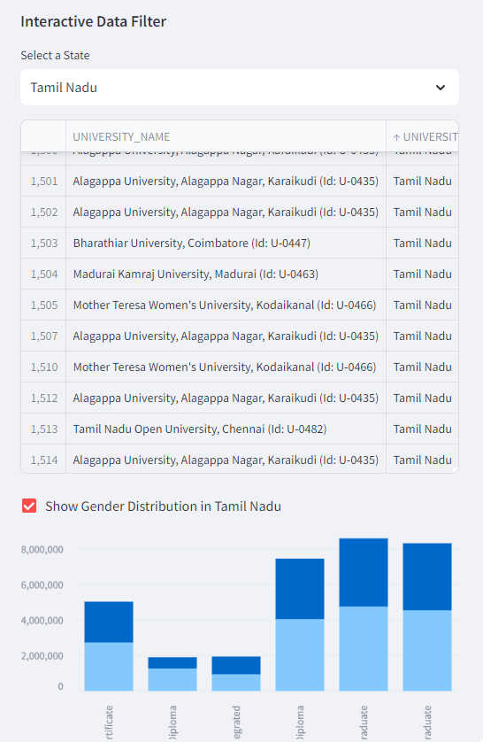
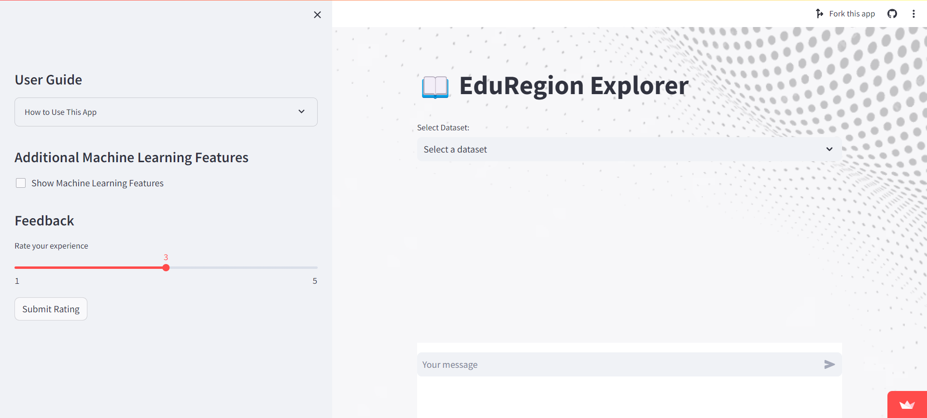
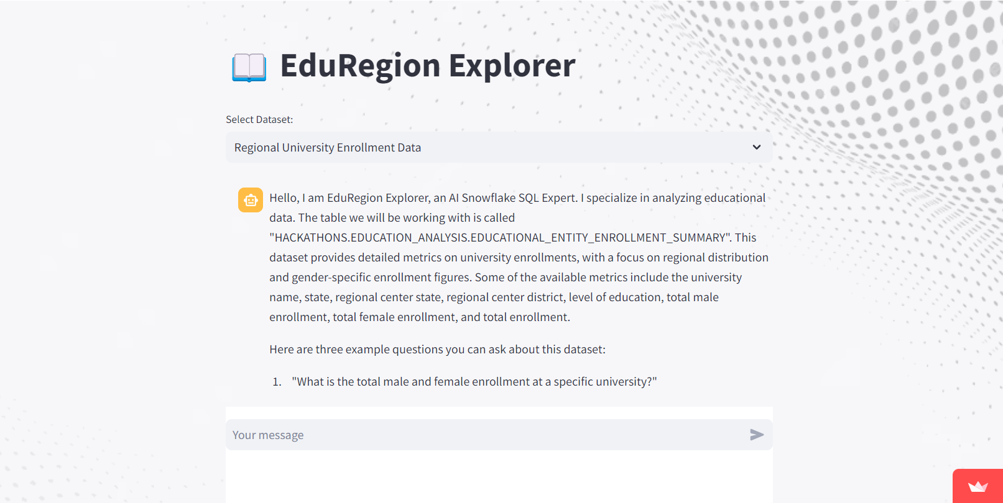
Embedded video,Github code,App Walkthrough
Youtube video Link:- https://youtu.be/6fkC8R6mYtc?si=JU2dJy9WazpvHOSh
Github Link:- https://github.com/MohamedFarhun/snowflake_hackathon_-EduRegion-Explorer
App Link:- https://eduregionexplorer.streamlit.app/
Screenshots of my app

Slide 7
Datasets used for my project EduRegionExplorer
Datasets in my LLM model:-
Regional University Enrolment Data:-(from data.gov) https://data.gov.in/resource/state-wise-male-and-female-student-enrolment-regional-centers-university-offering-0
Australian Educational Institutions
Insights:-(from snowflake marketplace-bonus points)
https://app.snowflake.com/marketplace/listing/GZSUZCN986/the-proptech-cloud-education-locations-insights-australia

Slide 8
THANK YOU

